Slide 1
Web basics
Web Programming

Slide 2
Plan for the day
Web Basics & HTML
GIT Introduction
HTML / HTML5
The Client - Server Model & HTTP
Divided into 4 ”Sections”
Were gonna dissect and get to know the web
Notes:
Personal advice, get a webhotel

Slide 3

Topics
Introduction
History of the web
Web pages in general
The basics
Introducing some basic concepts
Notes:
I will be feeding alot of information today to get the basic web stuff down asap.

Slide 4
Examples and slides
Available on GitHub
$ git clone https://github.com/ucnpbaweb/0915-Web-Programming-Front-end.git
$git pull
Keep up to date
Notes:
I will be introducing git later on

Slide 5

HTML
PHP
ASP.net
Javascript
Request
CSS
Response
HTTP
Web server
SOAP
JSON
Web browser
XML
Database
DNS
TCP/IP
URL

Slide 6
History of the World Wide Web
Developed by Tim Berners-Lee and other research scientists at CERN in the late 1980s and early 1990s.
WWW is a client-server model and uses TCP connections to transfer information or web pages from server to client.
WWW uses a Hypertext model. Hypertext allows interactive accesses to a collection of pages.
Webpages are in their essence, very simple
Notes:
NOTEPAD example

Slide 7
Web pages
Page can contain many different types of information; page must specify:
Content – The actual information
Type of content – The type of information, e.g. text (hypertext), Graphics, Sound, Animations, Video etc.
Links to other pages
Pages are linked together
Non-distributed – all pages are stored locally (e.g on CD-Rom).
Distributed – pages are stored at remote servers on the Internet.
Rather than having a fixed representation for every browser, pages are formatted with a mark up language.
This allows browser to format page to fit display.
Different browsers can display pages in different ways.
This also allows text-only browser to discard graphics for example.
Standard is called HyperText Markup Language (HTML).

Slide 8
Hyperlinks – or just ”Links”
Each page contains links (pointers) to other pages.
The link represented by "active area" on screen
Graphic - button
Text - highlighted
By selecting a particular link, the client fetches the referenced page from a server for display.
Links may become invalid.
Link is simply a text name for a remote page.
Remote pages may be moved to a new location while name in link remains in place.

Slide 9
HTML – What is it?
HTML specifies
Major structure of document
Formatting instructions for browsers to execute.
Hypertext links – Links to other documents
Additional information about document contents
Two parts to document:
Head contains details about the document.
Body contains the information/content of the document.
Each web page is represented in ASCII text with embedded HTML tags that give formatting instructions to the browser.
Formatted section begins with tag, <tagname>
End of formatted section is indicated by </tagname>

Slide 10
So the pic picture of HTML
Tags
Describes the elements of the website
Attributes
Adds information to the tag
Syntax
How is the language written. Where does the ”<></>” go.
The ”grammar” → How do you construct a correct sentence
Int i = ”hello” – Syntax OK
Semantics
The meaning of what you are writing
Int i = ”hello” – Semantically FAIL
More on semantic web later

Slide 11
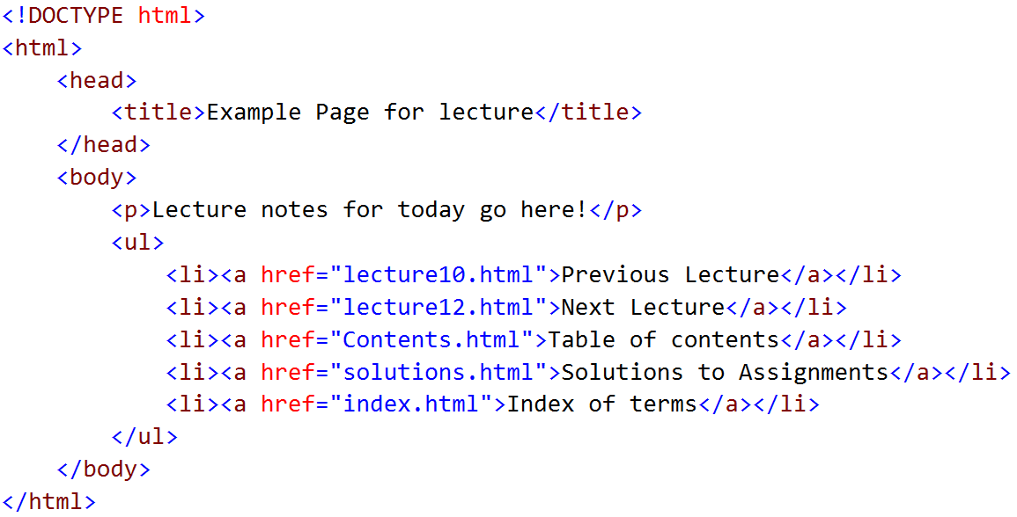
HTML – What does it look like?
Notes:
Quick walkthrough
We will discuss the elements in detail later

Slide 12
How is it read?
HTML is read left to right; top to bottom.
As is CSS and JS
This knowledge will be very important later.
Where do you put your scripts/.css
What happens if you have a css syntax error, or JS error.

Slide 13
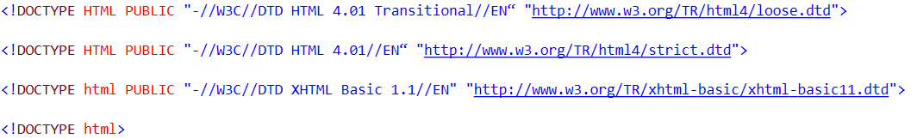
DOCTYPE and DTD
Defined by the W3C
Describes the HTML in the document, and how it should be read
If this is not done, the browser will assume a doctype; this can be problematic as browsers are implemented differently
We want our websites to look the same across all browsers
Different DOCTYPES
Add
If this is a XML document with the content-type application/xhtml+xml or text/xml.
Notes:
W3C: World Wide Web Consortium – Standardizing the web
Also standardizes CSS and much more.
HTML is based on XML. DTD’s are used to define certain rules for XML documents.
XML in itself doesnt have many rules.
We need rules and standards for rendering websites correctly across browsers.
4.01 loose dtd –
4.01 strict dtd –
Xhtml basic dtd –
Html NO dtd -

Slide 14
Various HTML Tags(elements) (not all)
Headings - <h1>, <h2>
Lists
<ol></ol> - Ordered (numbered) list
<ul></ul> - Unordered (bulleted) list
<li></li> - List item
Tables
<table>, </table> - Define table
<tr> </tr>- Begin row
<td> </td>- Begin item in row
Attributes
Keyword-value pairs in HTML tags
<table id=“myTable”></table>
Semantic elements(HTML5)
<nav></nav> - main navigation on the page
<main></main> - main content
<aside></aside> - secondary content
<section></section>
<article></article>
Structuring content
<p></p>
<div></div>
Self closing tags
<img/>
<br/>
Notes:
Tags have certain rules
Ex: <Li> tags has exist inside either <ol> or <ul> elements
Self closing tags:
Makes no sense to have elements inside a image or a line break.

Slide 15
Embedding Graphics
<img> tag specifies insertion of graphic
Parameters:
src="filename"
align= - alignment relative to text (or use CSS)
Height
width
Image must be in format known to browser:
Graphics Interchange Format (GIF)
Joint Photographic Experts Group (JPEG)
Portable Network Graphics (PNG)
Scalable Vector Graphics (SVG)
<img src="logo.png" height="35" width="30"/>
Notes:
QUICK Sanity check, what does <img src=“../../images/logo.png” height=“35” width=“30”/>
Pro question, is height,width attributes a good thing in this example?

Slide 16
HTML Special Characters
How can you express the danish letter Æ without having a danish keyboard?
How about the reverse exclamation mark?
We use HTML Special Chars
&#161; = ¡
&#9829; OR &hearts; = ♥
&#8734; = ∞
Using HTML char codes, the character will always be the same, if the computer has a valid charset installed.
Characters that cannot be rendered due to missing charset, are shown as a square: □
Notes:
Bonus info… to create special chars in windows, hold alt and press the correct key combination (find them on the web, or in START->RUN->charmap <ENTER> )
http://dev.w3.org/html5/html-author/charref ← Character reference

Slide 17
Hyperlinking
Each hyperlink is specified in HTML by using a special tag, the anchor tag.
An item on a page is associated with another HTML document.
Each link is passive, no action is taken until link is selected.
HTML tags for a hyperlink are <a> and </a>
The linked document is specified by parameter to the tag: href=“document-url“
Whatever is between the HTML tags, <a> and </a> is the highlighted hyperlink.
<a href=“http://www.google.com” target=“_blank”>Google Search</a>
Notes:
Target: _blank, _self, _parent, _top, framename

Slide 18
Styling / Cascading Stylesheets
HTML is marking up which content should exist, and where it should be in the document flow.
CSS is styling the HTML markup, and defining how it should look and where it should appear.
CSS can be defined in the <head></head> section of the website, or in external stylesheets. (.css files)
Styling can be applied with JS aswell, but this is just dynamically changing the styling

Slide 19
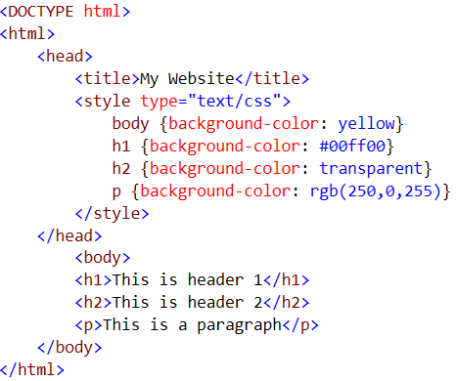
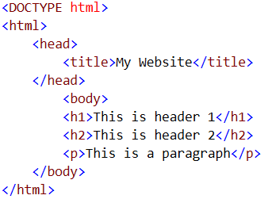
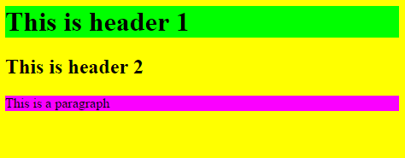
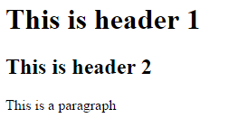
Styling - Continued
Notes:
Notice the different ways to define a background color. (RGBA and HSL can be used aswell)

Slide 20
How do we identify and navigate to a web page?
Specific syntax for Uniform Resource Locator (URL)
A web page is identified by:
The protocol used to access the web page.
The computer on which the web page is stored.
The TCP port that the server is listening on to allow a client to access the web page.
Directory pathname of web page on server.
These data are used to construct a HTTP request
Protocol examples are http, https;.
Computer name can be DNS name or IP address.
TCP port is optional (http uses port 80 as its default port).
Document name is path on server to web page (file or route).
Protocol://subdomain.host_name.tld:port/document_name(route)
Notes:
More on HTTP requests later
More on protocols later
What is a route?
What is a subdomain?
What is a toplevel domain?
Subdomain is a--- subdomain of host_name
Host_name is a subdomain of the top level domain
So if we define access to a web page as the colored example above, how come http://www.google.com works?

Slide 21
URL Example
http://dir.yahoo.com/Recreation/sports/soccer/index.html?id=1
Protocol: http
Subdomain: dir
Host name (DNS name): yahoo
Top level domain: .com
Port: 80
Pathname: /Recreation/sports/soccer/index.html
QueryString id=1
Notes:
When no port i specified in a browser web request, the browser assumes you mean port 80, the default webserver port.

Slide 22
Protocols / HTTP
The protocol which browsers and webservers use to communicate.
We will be discussing HTTP later in this lecture.

Slide 23
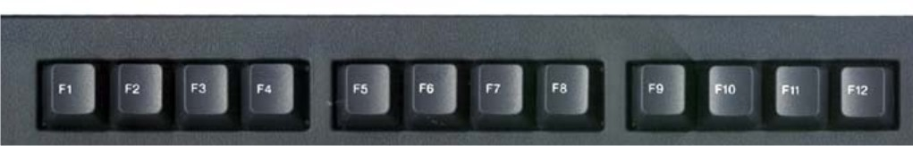
Developer Tools
F12, our bread and butter in web development
Both for design and code debugging
Not F12
F12
Notes:
Chrome, FF, IE/Edge

